Slide 1
Integration tests using pytest-docker
Muhammad Asif
muhammad.asif@emishealth.com

Slide 2
What is integration testing?
According to Wikipedia:
Integration testing (sometimes called integration and testing, abbreviated I&T) is the phase in software testing in which individual software modules are combined and tested as a group
Integration testing versus unit testing
In unit testing individual modules are tested
In integration tests all modules combined are tested.

Slide 3
Why use integration tests?
Bugs are caught earlier
High Confidence in your code
Code coverage is higher
Tests are written from the day one of the development cycles

Slide 4
How to do the integration testing?
Pytest-docker can be used to run integrations tests in python
Pytest-docker provides simple pytest fixtures that help write the integration tests with docker and docker-compose.
Pytest-docker spins up the docker containers and you can run the tests against the containers.
Link for the documentation:
https://pypi.org/project/pytest-docker/

Slide 5
Brief overview of pytest
The pytest framework makes it easy to write small, readable tests, and can scale to support complex functional testing for applications and libraries.
Demo

Slide 6
Pytest-fixture
Fixture initialises the tests function
Initialising may include installation, setups.
fixtures have explicit names and are activated by declaring their use from test functions, modules, classes or whole projects.
There are four parts of a test:
Arrange
Act
Assert
Clean up
Fixtures are Arrange steps.

Slide 7
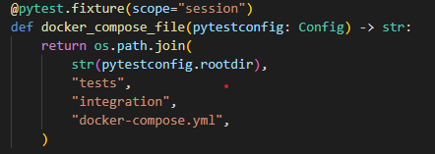
How to use pytest-docker
Create a docker-compose file
Define a fixture in conftest.py with name “docker_compose_file” and scope of session and return docker-compose file path in the fixture.

Slide 8
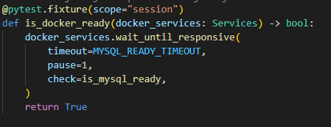
How to use pytest-docker (cont.)
Define a fixture is_docker_ready which uses docker_services fixture. It is used to wait until the services specified in the docker container are ready or not.

Slide 9
Demo for mysql

